Slide 1
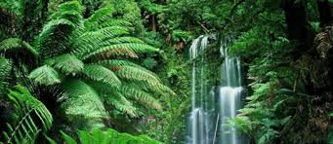
TROPICAL RAINFOREST BIOME
SEMESTER VI (HONS.)
DSE-4
Dr. Sujata Das
Deptt. Of Geography
Hooghly Women’s College

Slide 2
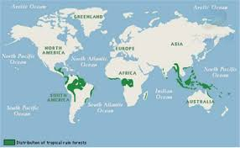
TROPICAL RAINFOREST BIOME
Carbon sink
Optimum Biome abundant moisture, water & heat
Location 10⁰ N to 10⁰S
Amazon Basin, Congo Basin, Java, Sumatra, Borneo, Malaysia & Sumatra
Climate Average rainfall 200cm or more, convectional in nature
Mean annual temp 20⁰c; annual range 10⁰c; daily range 50⁰c to 10⁰c

Slide 3
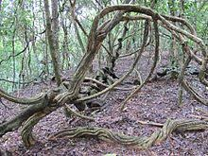
Vegetation * Trees account for 70% of the total plant species of the tropical rainforest biome
* Climbers/ creepers (P.W. Richards 1952)are divided into;-
# climbers of the lower strata include herbaceous plants
# long woody climbers/ Lianas are found from ground to the uppermost stratum
of the forest canopy, have thick woody stems(20cm or more in diameter), long
lengths (upto 240 m or more) & large crowns

Slide 4
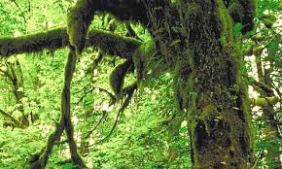
* ephiphytes which do not have roots on the ground & are found on trunks, stems, branches &leaves of trees, shrubs, herbs, climbers etc.
Ephiphytes (morphology) a) Holo Ephiphytes; roots never reach the ground b) Hemi Ephiphytes: evolved over branches, trunks & stems of trees & grow upwards but their roots reach the ground surface c) Pseudo Ephiphytes; evolved over the ground & grow upward, then their roots disappear but their upper parts are maintained d) Semi Parasite Ephiphytes; get their food from other autotrophic plants
(S.A. Cain & G.M. de Oliveiro Castro 1959)
Ephiphytes (forms) a) Macro Ephiphytes includes ferns b) Micro Ephiphytes includes moss, lichens, algae etc.

Slide 5
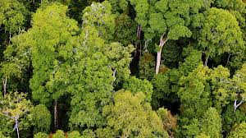
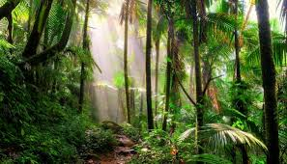
Vertical Stratification
*1ST/ Top Layer Stratum- looks like an umbrella but the level of the top surface is discontinuous & wavy; receives max amount of sunlight & intercepts rain drops, height is
30m to 60m, dominant layer
* 2nd Layer Stratum- upper crown is mop shaped, touches each other; height is 25m to 30m, co-dominant layer or second dominant layer
* 3rd Layer- trees have large leaves than first two layers as they trap more sunlight ; height is
15m to 20m
* 4th Layer- shrub layer; discontinuous, height is 5m or less from ground
* 5th Layer- herbaceous plants & ferns; height is 1m to 2m

Slide 6
Animal Life
J.L. Harison (1962) has divided animal life as follows;
* Upper Air Animal Community- insectivorous birds & bats like Asian falconet, Swifts,
Seviflet etc.
* Main Canopy Animal Community- birds & fruits bats like Toucans, parakeets, Barbets,
Cotingas, Currasows, Bill birds etc.
* Middle Zone Flying Animal Community- animals have climbing mechanisms & belong to carnivorous & herbivorous categories like Squirrels, Civets etc.
* Large Ground Animal Community- some birds but mostly animals like Mouse Deer,
Cassowaries, Elephants etc.
* Small Ground Animal Community – includes small animals & micro-organisms, mostly insectivorous like Argus Pheasant, Peacock, Guinea Fowl etc.

Slide 7
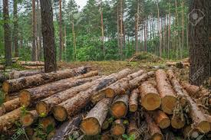
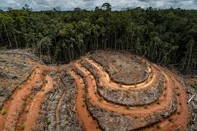
Anthropogenic Impact
Destruction of rainforest mining activity for precious metals like gold, silver; fossil fuels industrial activity agricultural activity
Construction of dams & reservoirs
Extinction of species
Protection
Preservation of habitat
Sustainable management techniques
International policy > market incentive programme REDD (Reducing Emissions from
Deforestation & Forest Degradation) for companies & govts to outset their carbon emissions through financial investments into rainforest conservation

